Slide 1
Random numbers

Slide 2
Randomness
The random module provides functions for generating random numbers
Computers are deterministic:
The same instructions given the same data (input) yields the same results every time
Usually this is what we want!
When would we want a program to do different things every time it’s run?
Games
Simulations of the real world: traffic, weather, galaxies colliding, …
Cryptography
For these kinds of problems we want random numbers
But how can we get real randomness in a deterministic machine?
There are ways (hooking up a radiation source and look for decays, etc. … ) but it’s not needed most of the time
Pseudorandom numbers are usually good enough for our purposes

Slide 3
Requirements for Randomness
What does “random” mean?
An even distribution of results
If we’re rolling a die, we expect 1 about 1/6th of the time
And 2 about 1/6th of the time, 3 about 1/6th …
Uniform distribution: each possibility is equally likely
This does NOT mean exactly uniform results!
If you roll a die six times, you will get some number twice
What it means is that over a large number of tests, the distribution gets closer to 1/6th each
Independent
An even distribution isn’t enough to be “random”
What if the die always rolled 1,2,3,4,5,6, 1,2,3,4,5,6,… in that order?
Random numbers should be unpredictable
Specifically seeing several numbers in the series should not let us guess the next one

Slide 4
Randomness involves information
Randomness involves information or the lack of it
Imagine you are standing at the top of a 50-story building.
If someone asked you to predict what the traffic at ground-level would be, “when will the next car come around the corner?” you would be in a good position to make a prediction because you can see the streets for a long way
If you were standing at ground level next to the same building, you have much less information and you could not make a very good prediction about the traffic
With more information, things are less random; with less information, things seem more random
That’s why the RNG numbers are called pseudo. With enough information, i.e. the RNG algorithm used and the seed, you could calculate the numbers just like the computer does. The numbers ARE predictable in that sense. Since we don’t usually have that info (or want to do that), the numbers seem random to us!

Slide 5
Types of RNG
PRNG-Pseudo random number generator
TRNG-True random number generator
PRF-Pseudo random function

Slide 6
Pseudorandom numbers
Pseudorandom numbers use a deterministic algorithm (a random number generator, RNG) to generate numbers that appear to be random:
Approximately uniform
Hard to predict (but theoretically not impossible)
ALL RNGs will repeat eventually, a good one does not for a very long time
A lot of research has gone (and goes) into RNGs
Linear congruential, Blum Blum Shub Generator, …
The Art of Computer Programming spends half a book on RNGs.
Why so much research? They are very important for security!
Cryptograph uses random numbers for session keys (like automatically generated one-time passwords)
If someone could predict the output of the RNG, they could predict the key and break in!

Slide 7
A good RNG
What makes a “good” random number generator?
The same features we mentioned earlier – uniform distribution, being unpredictable
It must be quick to calculate – a typical game would use millions of them
Most of them use integer arithmetic because it’s faster than floating point
It must have a long cycle before it repeats
EVERY RNG will eventually repeat if run long enough, but if the cycle is a few million numbers, it will seem “unpredictable” for most humans
Why will it repeat? Imagine you had a “perfect” RNG which would generate every possible number the computer could represent (in no predictable order). That’s a finite number of numbers. What if you asked for another random number after it had done that? It HAS to give you a number it has already given before! It has no others to give.

Slide 8
Two Pseudo Random Number Generators
Random number generation is a critical part of any cryptographic and spread spectrum systems in terms of strength and security.
A weak random number generation in a cryptographic or spread system could results in a compromised system.
As such number of cryptographic and spread spectrum systems depend on the generation of random and pseudo random bits for enhanced security.

Slide 9
A Pseudorandom Bit generator
This is an algorithm that utilizes deterministic procedures when given a seed to produce a sequence of random bits based on the seed value.
The input of PRBG is known as seed while the output is known as pseudorandom bit sequence.

Slide 10
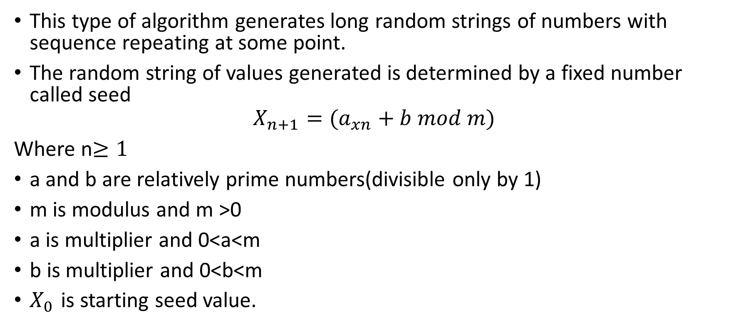
Linear Congruential Generator
This type of algorithm generates long random strings of numbers with sequence repeating at some point.
The random string of values generated is determined by a fixed number called seed
$$X_{n+1}=(a_{xn}+b mod m)$$
Where n$≥1$
a and b are relatively prime numbers(divisible only by 1)
m is modulus and m >0
a is multiplier and 0<a<m
b is multiplier and 0<b<m
$X_{0 }$is starting seed value.

Slide 11

Example of LCG
Given m=16;a=3;b=1
$$X_{n+1}=(a_{xn}+b mod m)$$
$X_{0=}\left(3×0+1 mod 16\right)=1$
$X_{1=}\left(3×1+1 mod 16\right)=4$
$X_{2=}\left(3×4+1 mod 16\right)=13$
$X_{3=}\left(3×13+1 mod 16\right)=8$
$X_{4=}\left(3×8+1 mod 16\right)=9$
$X_{5=}\left(3×9+1 mod 16\right)=12$
$X_{6=}\left(3×12+1 mod 16\right)=5$
$X_{7=}\left(3×5+1 mod 16\right)=0$
$X_{8=}\left(3×0+1 mod 16\right)=1$
Therefore generated sequence is (1, 4, 13 ,8, 9, 12 ,5, 0 ,1)

Slide 12
Cryptographically Generated Random Numbers
Blum Blum Shub Generator
A popular approach to generating secure pseudorandom number is known as the Blum, Blum, Shub (BBS) generator.
It has perhaps the strongest public proof of its cryptographic strength.

Slide 13
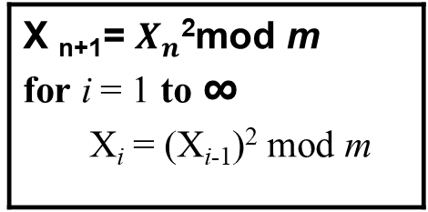
Cryptographically Generated Random Numbers
BBS Generator
Choose two large prime numbers p and q that have a remainder of 3 when divided by 4.
Let m = pq.
Choose a random number s that is relatively prime to m.
Produces a sequence of bits B_{i} according to he following algorithm.
X _{n+1}= $X_{n}\text{2}$mod m for i = 1 to ∞ X_{i} = (X_{i-1})² mod m

Slide 14

Example of BBS
X _{n+1}= $X_{n}\text{2}$mod m
Given X₀ =5,n=7,p=11
m=p*q
m=7*11=77
$X_{0}$=5$\text{2}$ mod 77
$X_{0}$=25 mod 77
$X_{0}$ =25
$X_{1}$=25$\text{2}$ mod 77
$X_{1}$ =625 mod 77
$X_{1}$ =9
$X_{2}$=9$\text{2}$ mod 77
$X_{2}$=81 mod 77
$X_{2}$ =4
{25,9,4,16,…}

